Slide 1

Software development
18013312
Jieun-Hong

Slide 2

Contents
Introduction to software development
Software development goals and implementation
While developing software
Software development
life cycle model used
The importance of teamwork
in the project

Slide 3

1. Introduction to software development
What is software development?
Software development is the process of turning market targets or user needs into software products.

Slide 4
The reason for developing software..
While thinking about the inconveniences I felt in my daily life, I tried to solve the inconvenience with software created through development.
Not only provides convenience and solutions to groups who felt uncomfortable
I started a software development project because I could make business results.

Slide 5
2. Software development goals and implementation

Slide 6
Mission.
Create the No.1 apartment app
Goal-
1
2
3
Core content reinforcement.
Reinforcing the community.
Efficient UI implementation.
Apartment management and bulletin board creation
Creating community bulletin boards on various topics for residents
In order to make it easy for various age groups to use, the UI should be easy to see.

Slide 7
3. While developing software...

Slide 8
The way it was done to achieve maximum performance within a given project period.
Organizational structure and division of roles in order to work efficiently
Team management and project planning can be saved by using a website that allows team members to plan work
Documented work and clearly recorded
Using the platform for effective communication among team members

Slide 9
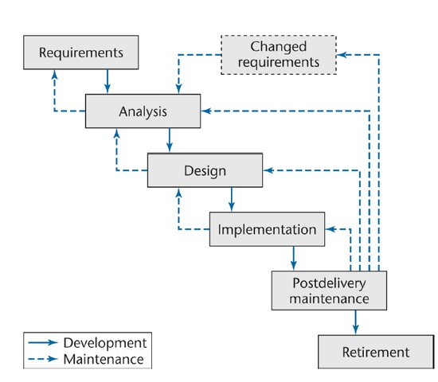
4. Software development life cycle model used: waterfall model
Waterfall model advantages:
1. It is a classic methodology,
and there are many applications.
2. Easy to understand the whole process.
3. The understanding of the current
stage is quick and easy.
4. It is easy to manage and
apply documents and outputs.

Slide 10
When we develop teamwork...
5. The importance of teamwork in the project
When we develop teamwork...
While the team's project deliverables are good, the project can lower costs and reduce schedules.
The morale of the team members is increased and the conflict of the team can be reduced.
Team members can participate in this decision making to improve the productivity of the team, resulting in more effective and efficient project results.
->Through the development of teamwork, the team was able to work effectively.

Slide 11
If this app is adopted by many apartments and used as an official apartment app,
-The apartment administration department will be able to quickly and easily notify the residents of the news.
-Residents will have an opportunity to communicate with many residents in the apartment by using the community bulletin board in the app.
Result:
Through an app made during software development..

Slide 12
At the end of the project...
I have felt a lot through my software development project.
I have felt a lot through my software development project.
.
That software development requires many people's cooperation and efforts.
When working on a project, it is important to have good communication with team members and stakeholders.
Planning and procedures are important in doing a project, and a lot of documents have to be written while working on a project.
The key to software development is to produce maximum results with minimum cost.
etc..

Slide 13
Thank you.

